Slide 1
Food Fortification as a Strategy for Nutrition Delivery- Does it Work?
GAIN’s experience around the world in fortification
Dr R Sankar, MD, MNAMS, FICP
Senior Manager and Regional Representative
Global Alliance for Improved Nutrition
Micronutrient Fortification of Foods: Science, Application & Management
January 7, 2011
New Delhi

Slide 2
Food Fortification as a Strategy for Nutrition Delivery- Does it Work?
GAIN’s experience around the world in fortification
GAIN project portfolio
Evidence from completed projects
Critical success factors for FF

Slide 3
GAIN at a Glance
Created within the UN in 2002 during the Special Session of the UN General Assembly on Children
Redesigned as a Swiss foundation in 2005
Headquarters in Geneva, Switzerland
Offices in New Delhi, Johannesburg, Washington DC, Cairo, Nairobi, Bangladesh, Kabul,
Notes:
The Special Session was a landmark, the first such Session devoted exclusively to children and the first to include them as official delegates. It was convened to review progress since the World Summit for Children in 1990 and re-energize global commitment to children's rights.

Slide 4
Nutrition Program
Nutrition Program
National Food Fortification
Universal Salt Iodization
Infant and Young Child Nutrition
Nutrition and Infectious Diseases
GAIN premix facility
Population Based Nutrition Programs
Targeted Nutrition Programs
Goal: Develop and deliver high quality population based and targeted programs that will contribute to GAIN’s target of reaching 1 billion people
Notes:
The goal of GAIN’s Nutrition Program is to develop and deliver high quality population-based and targeted programs that will contribute to GAIN’s target of reaching 1 billion people. Population-based programs deliver staple foods and condiments fortified with vitamins and minerals to large populations through market-based approaches. GAIN’s National Food Fortification Program and the GAIN-UNICEF Universal Salt Iodization Partnership Project are population-based programs. Targeted programs deliver fortified food products including complementary foods and supplements to specific population groups including infants and young children, pregnant women and nursing mothers, school children, people suffering from infectious diseases, remote rural populations, refugees or displaced peoples as well as those seriously affected by the economic crisis. The Infant and Young Child Nutrition Program and the Nutrition and Infectious Diseases Program are targeted programs.
The GAIN-UNICEF Universal Salt Iodization (USI) Partnership Project contributes to global efforts to eliminate iodine deficiency through salt iodization in 13 countries with the lowest coverage of iodized salt and the greatest burden of iodine deficiency. The project aims to reach 90 percent of the population in these 13 countries (Bangladesh, China, Egypt, Ethiopia, Ghana, India, Indonesia, Niger, Pakistan, Philippines, Russia, Senegal and Ukraine) with adequately iodized salt. By the end of the Project, the Partnership will have helped to reach more than 790 million people not yet covered by worldwide salt iodization programs, including more than 19 million new born infants every year.
All GAIN programs are supported by the GAIN premix facility (GPF). GPF provides services related to the procurement and certification of premix, a commercially prepared blend of vitamins and minerals used to fortify staple foods, to food fortification projects around the world. The Integrated Program Strategy will aggregate different project delivery strategies in five highly populous countries and regions with widespread malnutrition to increase the combined impact and reach of GAIN’s investment in a sustainable way.

Slide 5
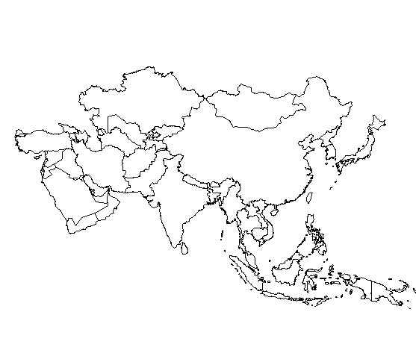
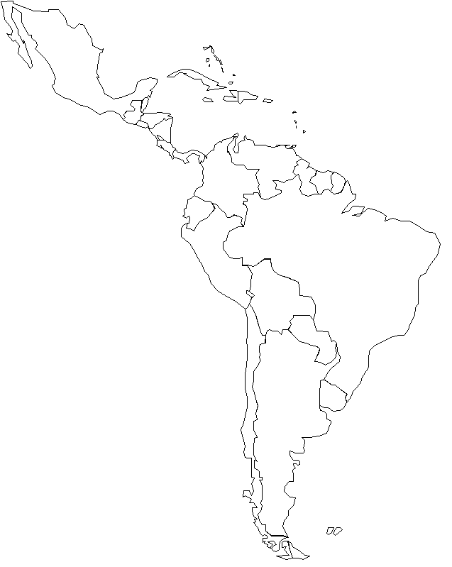
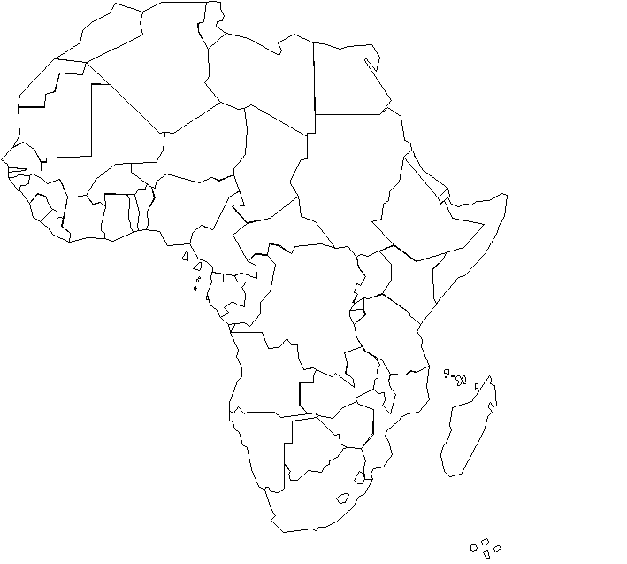
GAIN Projects Worldwide
Africa
Asia
South America
Salt Iodization
36 projects in 27 countries, fortifying staple foods, condiments, and complementary foods with
vitamins and minerals
National Food Fortification
Infant and Young Child Nutrition
Notes:
5 projects in infant and young child nutrition (new Philippines project), 18 projects in national food fortification (including new wheat flour and oil fortification project in Senegal), 13 projects in salt iodization

Slide 7
Reach and Coverage

Slide 8
National Fortification Programs
Wheat Flour | Vegetable Oil | Other vehicles
Cote d’l voire South Africa Georgia Ghana Bolivia Egypt Uganda Kazakhstan Nigeria Senegal India Morocco Pakistan Kenya | Cort d’lvoire Ghana Egypt Uganda Nigeria Bangladesh Senegal Indonesia Morocco India Kenya | Soy Sauce - China Maize meal – Nigeria, SA, Kenya Milk – India, Kenya
Notes:
GAIN’s national level food fortification programs are currently operating in 18 countries with high levels of vitamin and mineral deficiencies.
All these programs are national in scale and not pilots.
These programs are guided at national level by National Fortification Alliances, which are multistakeholder alliances.
All the national programs are essentially public-private-partnerships.
The focus in these programs is to bring about systemic changes in the countries that will enable food fortification.
Measurement of public health impact is integral to all these programs.

Slide 9

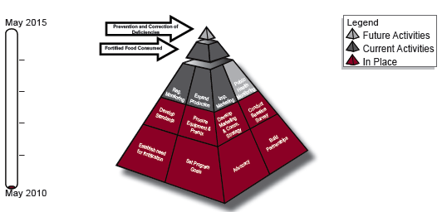
National Fortification Program
Pakistan
Project is in its second phase
125 of 170 mills are fortifying wheat flour
Proposed to scale up to include 275 mills
More than a million MT is fortified with NaFe EDTA and FA
More than 8 million persons are reached. At scale reach will be 37 mio

Slide 10
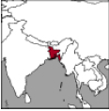
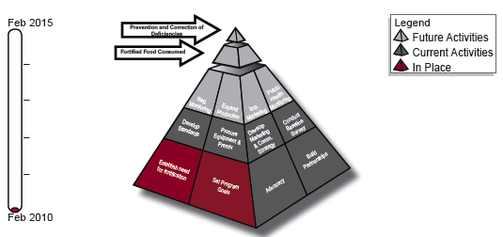
National Fortification Program
Bangladesh
Aim is to fortify all refined vegetable oil
First batch of fortified oil will be in the market by June 2011
All 17 refineries will participate
1.2 mio MT of refined oil will be fortified with vitamin A @ 20 IU/gram
At scale the project will reach more than 120 million persons

Slide 11
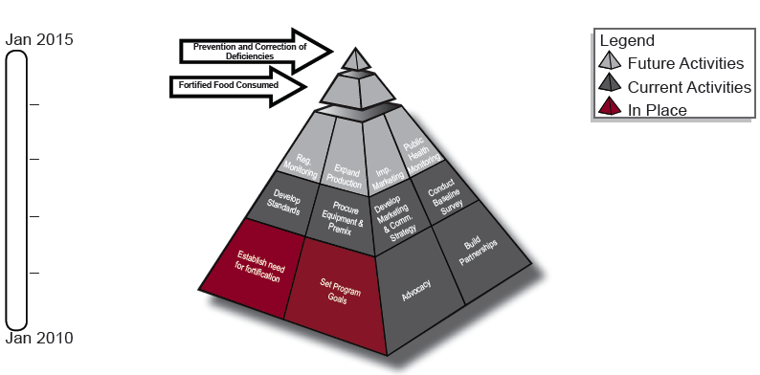
National Fortification Program
India
Wheat flour fortification in Bihar and MP
All wheat processed through the RFMs in these two states will be fortified with iron and folic acid
Fortified flour will be sold through market channel and PDS
At scale the project is expected to reach 50 million persons

Slide 12
Strategic initiatives - India
Done in collaboration with Naandi Foundation
Covers central kitchens in AP, MP, Rajasthan, Orissa
Fortified wheat flour, soya dal analogue and fortified biscuits
Reaches more than one million children
Fortified blended food is distributed to children 6 – 36 months
GAIN’s support – premix, QC/QA, new packaging, communication
Government of Gujarat has scaled it up and FBF is the norm now
Reaches 1.2 million children. Utilization increased from 35% to >80%
Done in collaboration with Naandi Foundation
Covered 50,000 children in Vizag central kitchen
Used this to study various logistics and feasibility of integration in MDM
MDM
ICDS
Ultra Rice

Slide 13
Food Fortification as a Strategy for Nutrition Delivery- Does it Work?
Evidence from Completed Projects
Vehicle: Soy Sauce
Fortificant: Iron
Grant: US $3 million
Effectiveness Trial (Chen, 2005)
  Data showed approximately a one third decrease in the prevalence of anemia for women of reproductive age and children 3-6 years old
Similar trends reported by the Chinese CDC via their sentinel site monitoring system
Studies on the effectiveness of NaFeEDTA-fortified soy sauce in controlling iron deficiency: a population-based intervention trial.
Institute of Nutrition and Food Safety, Chinese Center for Disease Control and Prevention, Beijing, China jshchen@ilsichina.org
Food Nutr Bull. 2005 Jun;26(2):177-86; discussion 187-9
Notes:
Follows effectiveness study carried out prior to program inception
Soy sauce fortified with NaFeEDTA

Slide 14
Food Fortification as a Strategy for Nutrition Delivery- Does it Work?
Evidence from Completed Projects
Vehicle: Wheat Flour and Maize Meal
Fortificants: Iron, vitamin A, zinc, thiamin, riboflavin, niacin, folic acid
Grant: $2.8 Million
Birth Defects Surveillance System
  Established in 2002 in 12 public hospitals in 4 provinces.
  Since 2002, 53,000 births/year have been monitored.
Perinatal Mortality Surveillance System
  Causes of death up to seven days of age are recorded through 164 sentinel health care facilities.
14
Notes:
14
The National Food Fortification Survey- 2005 reported on the change in the rate of neural tube defects (NTD) in South Africa after the country’s mandatory fortification legislation was enacted.
To measure the prevalence of NTD in the country, a surveillance system was established in 2002 amongst 12 public hospitals in four provinces in South Africa. Since 2002, the system has captured over 53,000 births a year. In 2003, the South Africa Department of Health initiated the collection of NTD data to measure the effect mandatory fortification of wheat flour and maize meal had on the prevalence of NTD and to determine the effectiveness of folic acid fortification in South Africa.
The pre-fortification estimates of NTD prevalence vary between urban locations such as Pretoria and Cape Town with rates from 0.99 to 1.3 per 1000 births and rural locations such as the Eastern Cape Province with rates as high as 6.1 per 1000 births. The previous national survey based on collected NTD data from mostly urban sites reported the national prevalence of NTD in South Africa to be 1.2 per 1000 births.
Utilizing data collected from the surveillance system, the NFFS compared incidence rates of NTD between the periods of January 2003 to June 2004 and October 2004 and March 2005. The study found that the prevalence of NTD was reduced by 30.5% from 1.41 to 0.98 per 1000 births after mandatory fortification (p<0.05).

Slide 15
Results from Completed Projects:
South Africa: Birth Defects Surveillance
  Prevalence of NTDs was reduced by 30.5% after mandatory fortification (p<0.05).
Prevalence of NTDs in South Africa Pre and Post Mandatory Folic Acid Fortification Legislation
Province | Pre Fortification (2001-2003) | Post fortification (2005-2006)
 | Rate/1000 Births | Rate/1000 Births
Eastern Cape | 2.11 | 1.26
KwaZulu Natal | 1.05 | 0.78
Mpurnalanga | 1.36 | 1.02
Free State | 1.29 | 1.03
Total | 1.41 95% CI: 1.15-1.67 | 0.98 95% CI: 0.69-1.26
Sayed AR., Bourne D., Pattinson R., Nixon J., Henderson B. Decline in the prevalence of neural tube defects following folic acid
fortification and its cost-benefit in South Africa. Birth Defects Res A Clin Mol Teratol. 2008 Apr;82(4):211-6.
Sayed AR., Bourne D., Pattinson R., Nixon J., Henderson B. Decline in the prevalence of neural tube defects following folic acid
fortification and its cost-benefit in South Africa. Birth Defects Res A Clin Mol Teratol. 2008 Apr;82(4):211-6.
Notes:
Perinatal Problem Identification Program (PPIP)
Existing perinatal mortality surveillance system
Identifies the common causes of death and associated factors which could be addressed to reduce the perinatal mortality rate
Basic perinatal birth data and causes of death up to seven days of age are recorded through 164 sentinel health care facilities
A category of NTDs was included in the classification in anticipation of folic acid fortification
There was a significant decline of 65.9% in NTD perinatal mortality, from 0.42 to 0.14 per 1000 births (P<0.001).
As a control the perinatal mortality rate of hydrocephalus, unrelated to NTDs, did not change significantly (P=0.7732).

Slide 16
Food Fortification as a Strategy for Nutrition Delivery- Does it Work?

Slide 17
Food Fortification as a Strategy for Nutrition Delivery- Does it Work?
Critical factors for success (Primary Foundational Blocks)
  Choosing a vehicle
  Food Industry and market related
  Food laws and regulation
  Building PPP and alliances

Slide 18
Food Fortification as a Strategy for Nutrition Delivery- Does it Work?
Choosing a vehicle
  Food consumption data for potential food vehicle(s)
  Marketing and distribution data for the food vehicles(s)
  Determining the technical and economic feasibility
Notes:
One of the key process in developing a food fortification program is choosing a suitable food vehicle. This can be a challenge, especially in countries with large rural populations, a small food industry with limited technology, and limited access and low consumption of processed foods.
A food fortification vehicle should be chosen based on key factors, including consumption patterns, marketing and distribution data, and economic and technical feasibility.

Slide 19
Food Fortification as a Strategy for Nutrition Delivery- Does it Work?
Food Industry and market analysis
  Industry capacity & concentration
  Public – private share and role
  Investment climate for food fortification
Notes:
One of the features that distinguishes food fortification from many other public health initiatives is the high level of involvement and motivation required of the food industry.
Successful achievement of food fortification has a complex relationship to the level of economic development.
The situational analysis should include a review of the industrial capacity. What is the installed capacity and what is the capacity that is utilized.
Look at what is the share of the public and private industry.
In many developing countries there are subsidies and price controls of staple food. In such a scenario the food companies operate on thin profit margins and are not willing to take on the additional cost of fortification unless assured of consumer demand.

Slide 20
Food Fortification as a Strategy for Nutrition Delivery- Does it Work?
Food laws and regulation
    Voluntary fortification
    Mandatory fortification
    Monitoring and enforcement
    Role of Govt & Food Industry
Notes:
Unlike in the developed countries, developing country fortification experiences have relied extensively on mandatory legislation as key to achieving sustainability of a food fortification program.
We know from our experience that voluntary fortification in many developing countries have failed. More over, voluntary fortification of nonstaple foods commonly initiated by the private industry does not reach the target population groups at risk for nutritional deficiencies.
Several developing countries have set in place and enforce mandatory fortification laws.
Legislation presupposes an effective monitoring and enforcement based on the partnership of relevant food industries and governmental agencies.
In such a partnership, the government seeks improved public health, and the industry seeks protection against competition with unfortified products.

Slide 21
Food Fortification as a Strategy for Nutrition Delivery- Does it Work?
Barriers - Consumers
Nutrition Low Purchase Priority
Price Sensitivity
No Perceived Need. Hidden Hunger
Prevention & Future Benefits
The most at risk choose
the least expensive product

Slide 22
Food Fortification as a Strategy for Nutrition Delivery- Does it Work?
Barriers - Producers
  Little Price or Volume Increase
  Competition and Price Pressure
  Low Profit Margins
  Low Capacity Utilization
It is not the Cost
It is the Competition

Slide 23
IPS Rajasthan
Staple Food Fortification
Wheat Flour
Edible Refined Oil
Milk
Through commercial Market Channels
Fortification of Food Aid
IPS Rajasthan
ICDS
MDM
PDS
To set up innovative projects to fortify the food aid that is given in the safety net programs
Innovations
Small Scale
Fortification
Nutrition &
HIV /AIDS
Set up large pilot s on
small scale fortification
HIV/AIDS and Nutrition
Other GAIN Programs
IYCN
USI
There are other GAIN Programs in Rajasthan which will enhance the reach of IPS

Slide 24
Thank You

